Slide 1
WO3193 Last measurement
Date: 2019 12 31
Measured with coax cables and sourcemeter
Voltage sourced

Slide 2
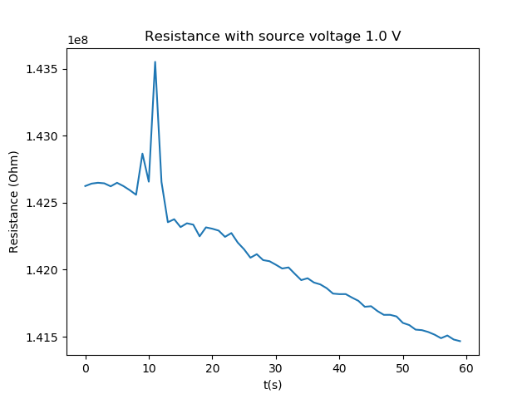
Parameters & Resistance
Temperature setpoint is 25 C
Sample rate is 1 Hz
Measurement time is 60 s
Source voltage is 1.0 V
Limit current starts at 1.5e-08 A
Mean resistance is 7.104520e+07 with std 7.104583e+07

Slide 3
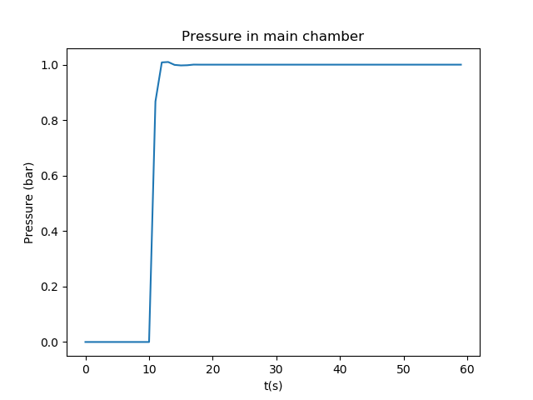
Reaction to H2
H2 introduced around 10 s in, but resistance does not change at all
Maybe sample is not working after being left in the chamber exposed to air for a number of weeks (last measurement was 26 november)

